Slide 1




Seminar:
Introduction to Cloud Computing
Jeff Prevost, Ph.D.

Slide 2
Outline
Motivation: Growth and carbon footprint
Cloud 101: Important concepts that define cloud
Energy Optimization
Current Cloud Research
The Open Cloud Institute

Slide 3
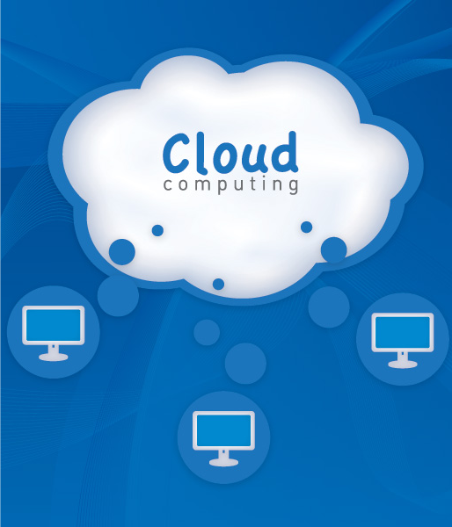
Part 1
Motivation

Slide 4
Motivation: Challenges in Cloud Computing
In 1995 there were 18,000 websites
By 2009, 125 million websites and growing
Green movement forcing hand of Cloud Data Centers (CDC) operators to become more efficient

Slide 5
Motivation: Challenges in Cloud Computing
Cost per Virtual Machine (VM) lower the larger the CDC becomes.
This drives Cloud Providers to build larger and larger CDCs.
In 2011, CDCs consumed 1.5%+ of total US electricity consumption, ~31GW

Slide 6
Motivation: Challenges in Cloud Computing
Microsoft said it had over 1M servers in 2013
Google has even more!
…not to mention Amazon, Rackspace, Yahoo…

Slide 7
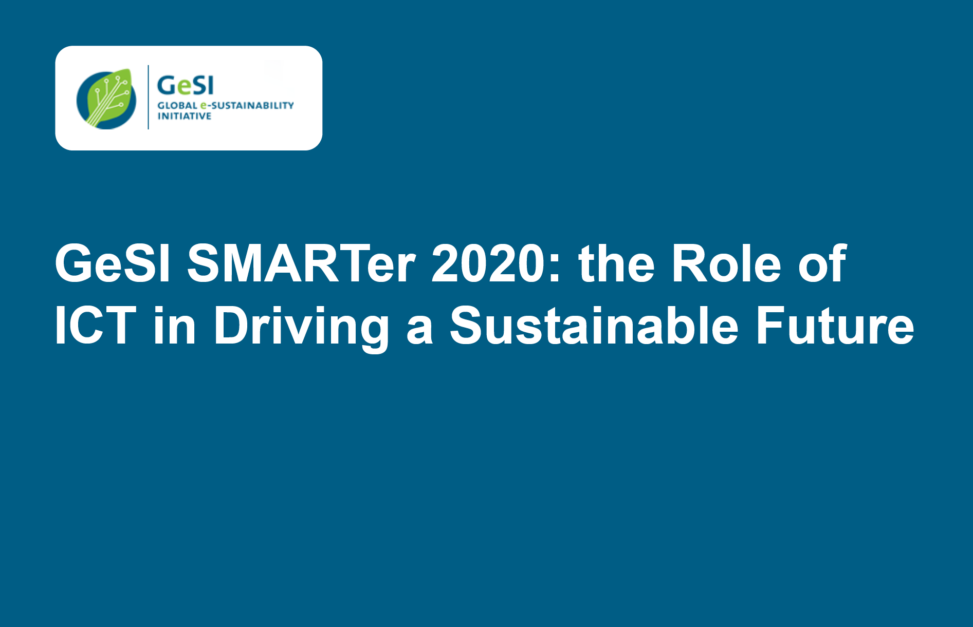
But the Cloud promises to actually save energy
Study done to re-calculate the total reduction in carbon that can potentially be saved by technology such as Cloud Computing

Slide 8
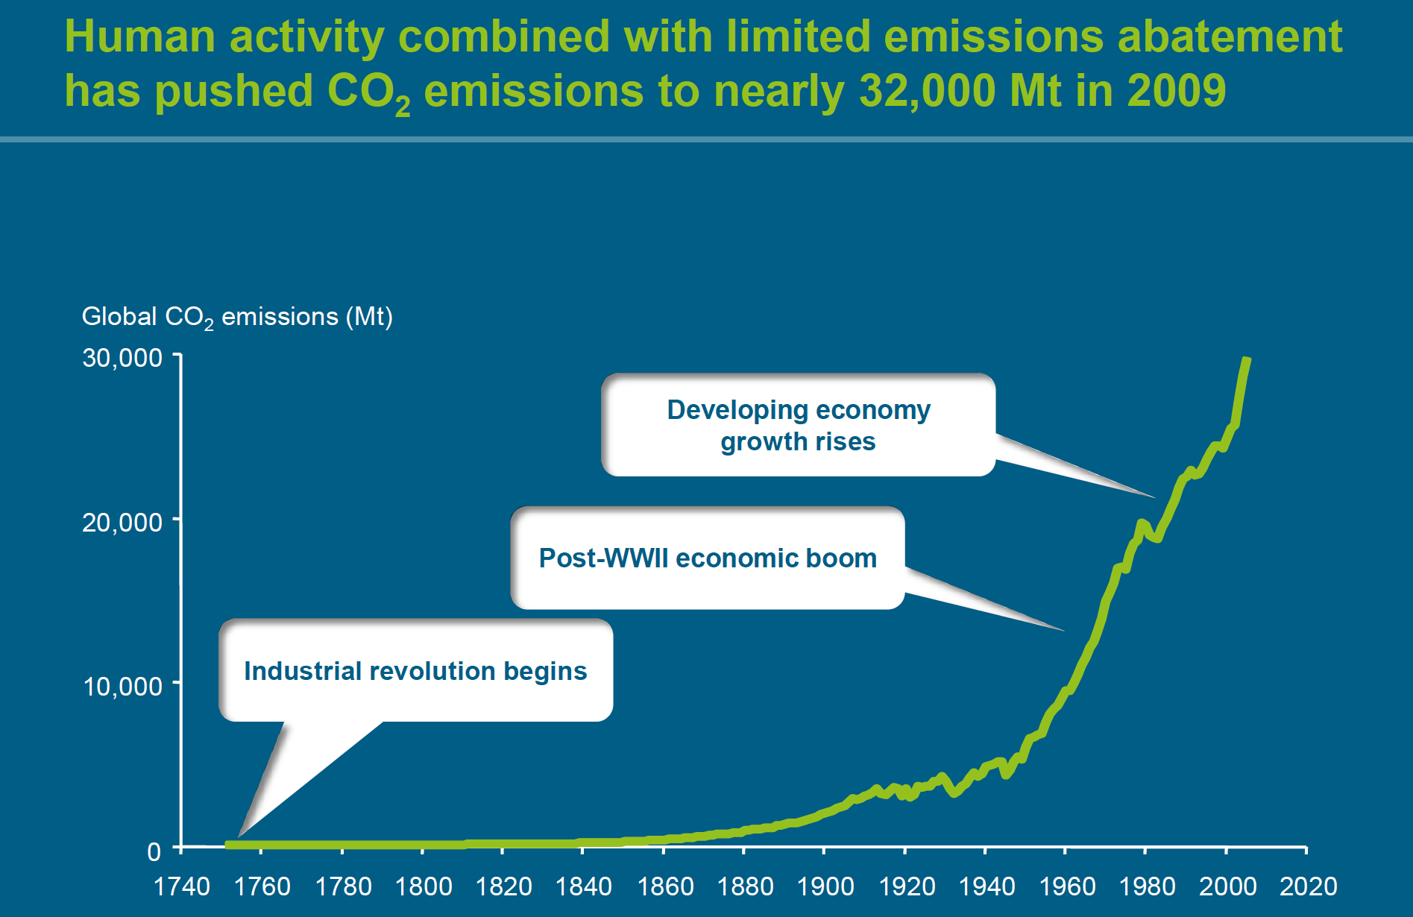

Slide 9
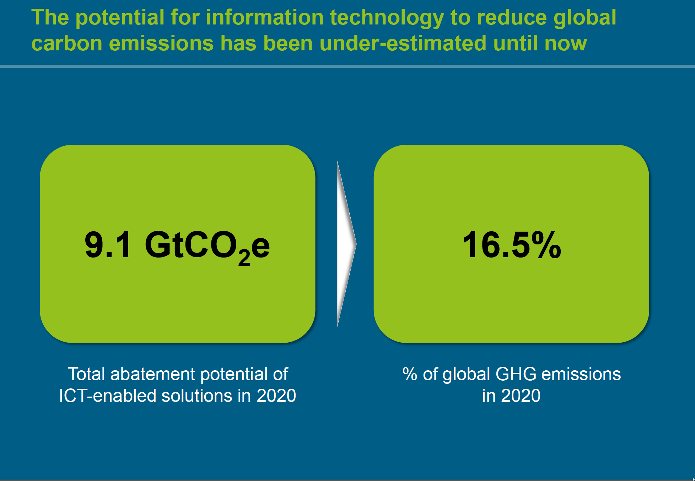

Slide 10
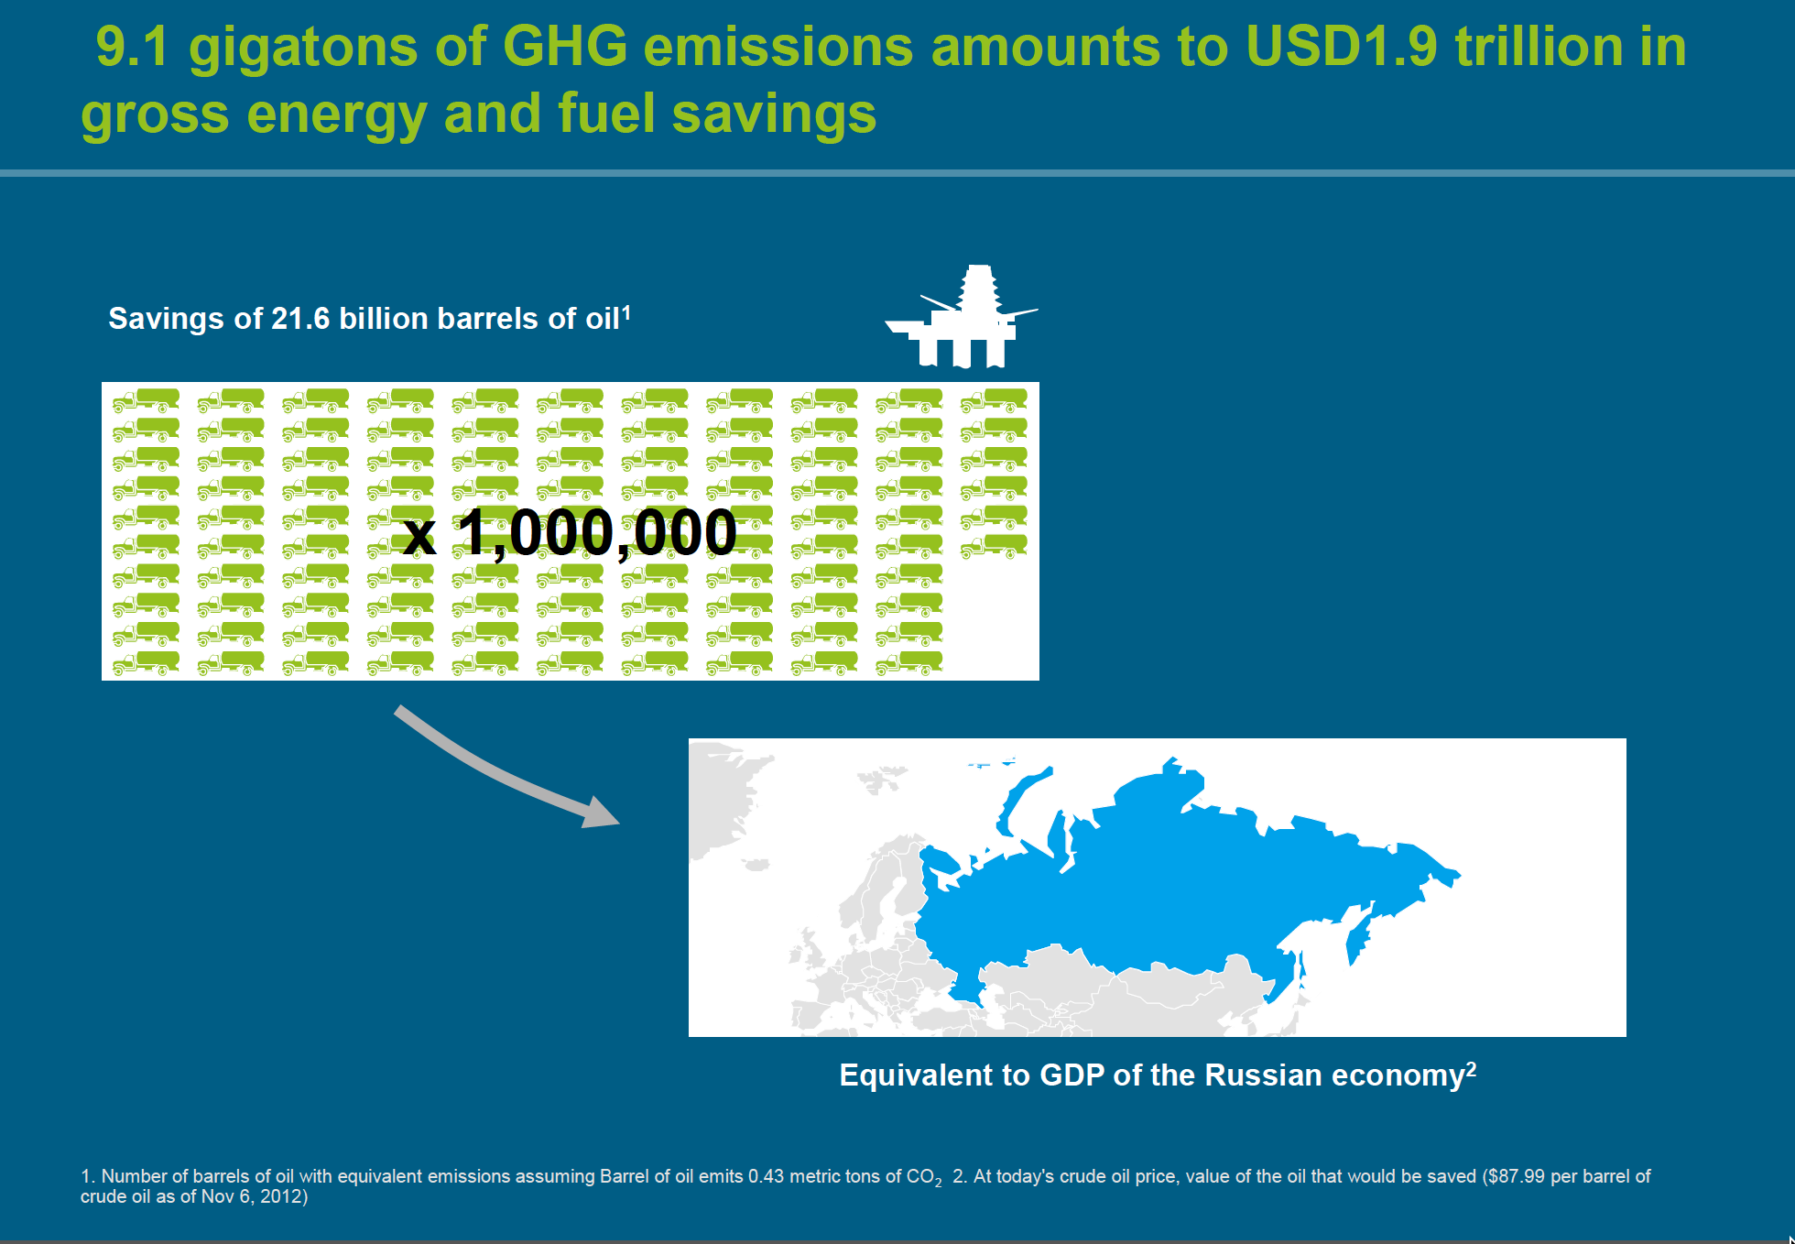

Slide 11
Part 2
Cloud 101

Slide 12
So what is the “Cloud”?
"Cloud computing is a model for enabling ubiquitous, convenient, on-demand network access to a shared pool of configurable computing resources (e.g., networks, servers, storage, applications, and services) that can be rapidly provisioned and released with minimal management effort or service provider interaction."
–National Institute of Standards and Technology (NIST)

Slide 13
To be Cloud, you need…
On-demand self-service
Broad network access
Resource pooling (Grid Computing)
Rapid elasticity (Virtualization)
Measured service (Utility Based Pricing Model)

Slide 14
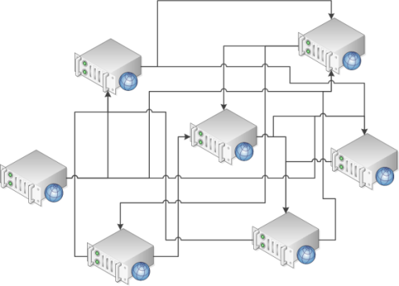
Cloud Computing Concepts: Grid Computing
Grid computing is the collection of computer resources from multiple locations to reach a common goal.

Slide 15
Cloud Computing Concepts: Utility Computing
Utility computing is a service provisioning model in which a service provider makes computing resources and infrastructure management available to the customer as needed, and charges them for specific usage rather than a flat rate.

Slide 16
Cloud Computing Concepts: Load Balancing
Load balancing is dividing the amount of work that a computer has to do between two or more computers so that more work gets done in the same amount of time and, in general, all users get served faster.
Load balancing can be implemented with hardware, software, or a combination of both.

Slide 17
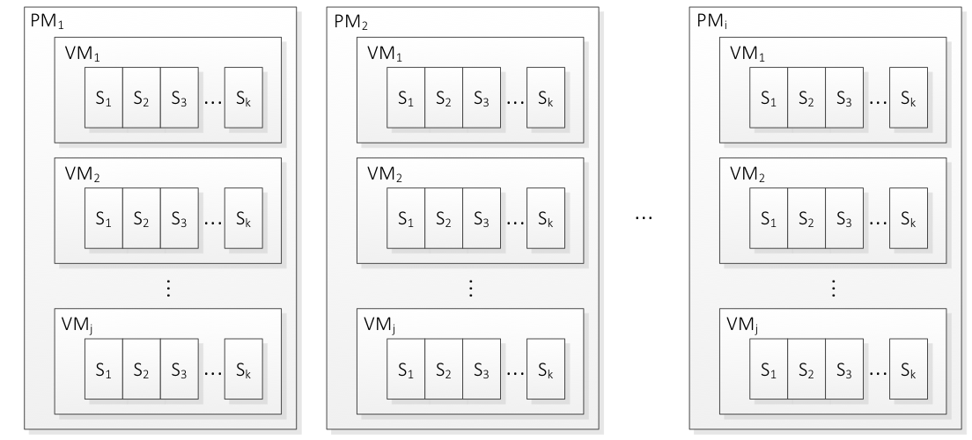
Cloud Computing Concepts: Virtualization
Virtualization is the creation of a virtual (rather than actual) version of something, such as an operating system, a server, a storage device or network resources.
Single VM
Multiple VMs

Slide 18
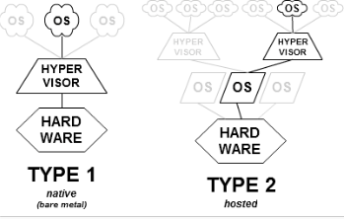
Cloud Computing Concepts: Virtualization
Hypervisor is the software that manages the virtual layer in a physical machine.

Slide 19
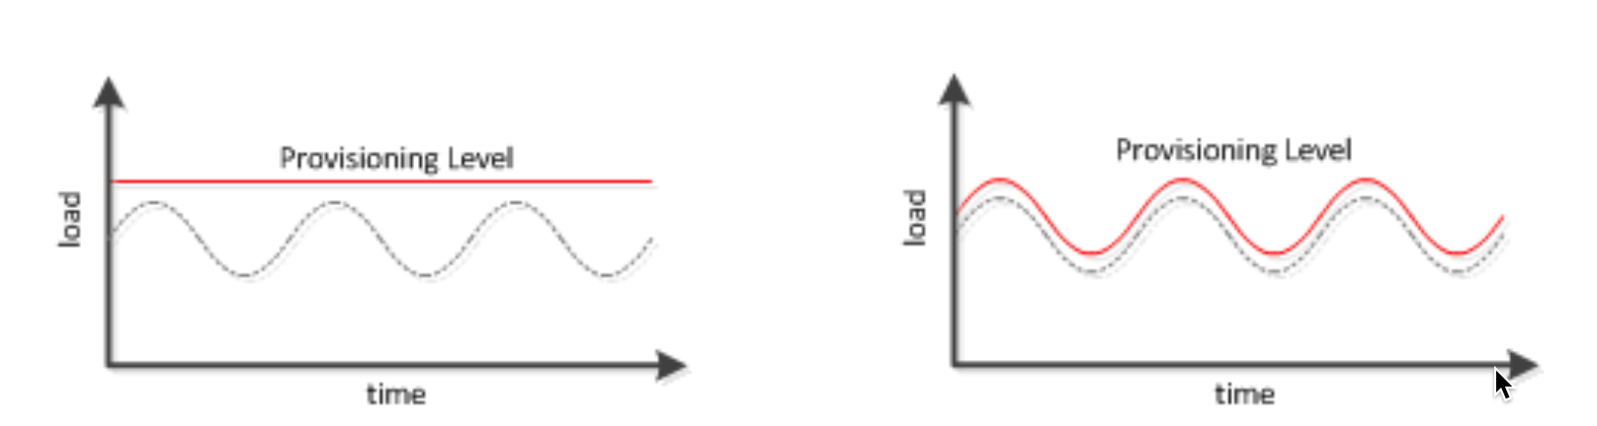
Cloud Computing Concepts: Elasticity
Elasticity is defined as the degree to which a system (or a particular cloud layer) autonomously adapts its capacity to workload over time.
Old way
Cloud way

Slide 20
Cloud Computing Service Layers
The Cloud computing layered model
Cloud Clients
Web browser, mobile app, thin client, terminal emulator, …
SaaS
CRM, Email, virtual desktop, communication, games, …
Use Provider’s applications over a network.
PaaS
Execution runtime, database, web server, development tools, …
Create and deploy customer- created applications to a cloud.
IaaS
Virtual machines, servers, storage, load balancers, network, …
Rent Processing, storage, network capacity and other fundamental computing resources.
Notes:
SaaS example is SalesForce
PaaS example is Windows Azure
IaaS example is Rackspace

Slide 21
Types of Cloud Computing
On Premises/
Internal
Private/
Internal
Public
Hybrid
The Cloud
Private/
Internal
Federated

Slide 22




Cloud Computing Leaders
Amazon EC2
Google Cloud Services
Microsoft Windows Azure
Rackspace Public Cloud

Slide 23
Part 3:
Energy

Slide 24
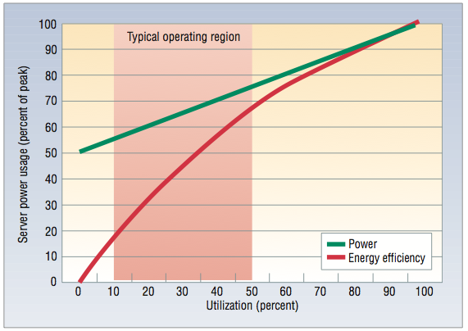
Typical Cloud Server Energy Use
Typical Data Center servers run between 10% and 50% utilization, and consume between 55% and 75% of their peak power. [Barroso 2010] Idle servers waste energy.
Servers in “sleep” state consume ~10% of their peak power.

Slide 25
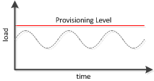
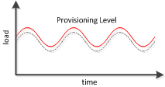
Should change the way we run servers
How can we achieve an optimal state?
Change Server state to Sleep when conditions allow

Slide 26
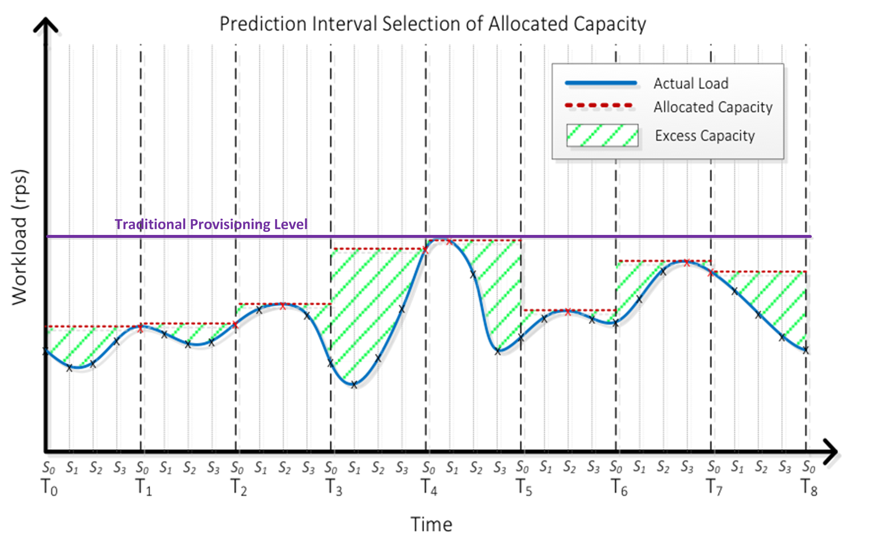
Results are lower energy consumption

Slide 27
Current Research in Cloud
Cloud Based Control of Robots (distributed control problem) - TECHLAV
Cloud Based Communications (C-RAN: Baseband Modulation in the Cloud)
Bioinformatics (Brain Research, Genomics, Proteomics)
Cloud Advanced Modeling (airframes, geologic topology)
Quantum Cryptography (Key Distribution) for advanced security in Cloud

Slide 28
Cloud Robotics and Automation
Why should we connect robots to the cloud?
Shared Information: To provide access to global libraries of images, maps, object data, all eventually annotated with geometry and mechanical properties.
Computation Power: Allow for massively-parallel computation on demand for demanding tasks like optimal motion planning and sample-based statistical modeling.
Cooperative Control: Sharing of outcomes, trajectories, and dynamic control policies.
Common Knowledge: Human sharing of “open-source” code, data, and designs for programming, experimentation, and hardware construction.
Man-In-The-Loop: On-demand human guidance (think “call-centers”) for exception handling and error recovery.
Optimized Compute: Distributed processing for optimal calculations (offload big tasks to the cloud, keep low-latency tasks onboard robot

Slide 29
Part 4:
OCI

Slide 30
The Open Cloud Institute at UTSA
Established Feb. 26th 2015
Initial ~10 million seed grant
Part of NSF Cloud Grant (10M total grant)
Open Compute Project Testing Lab
Part of the Intel Innovation Center, a partnership between Rackspace and Intel

Slide 31
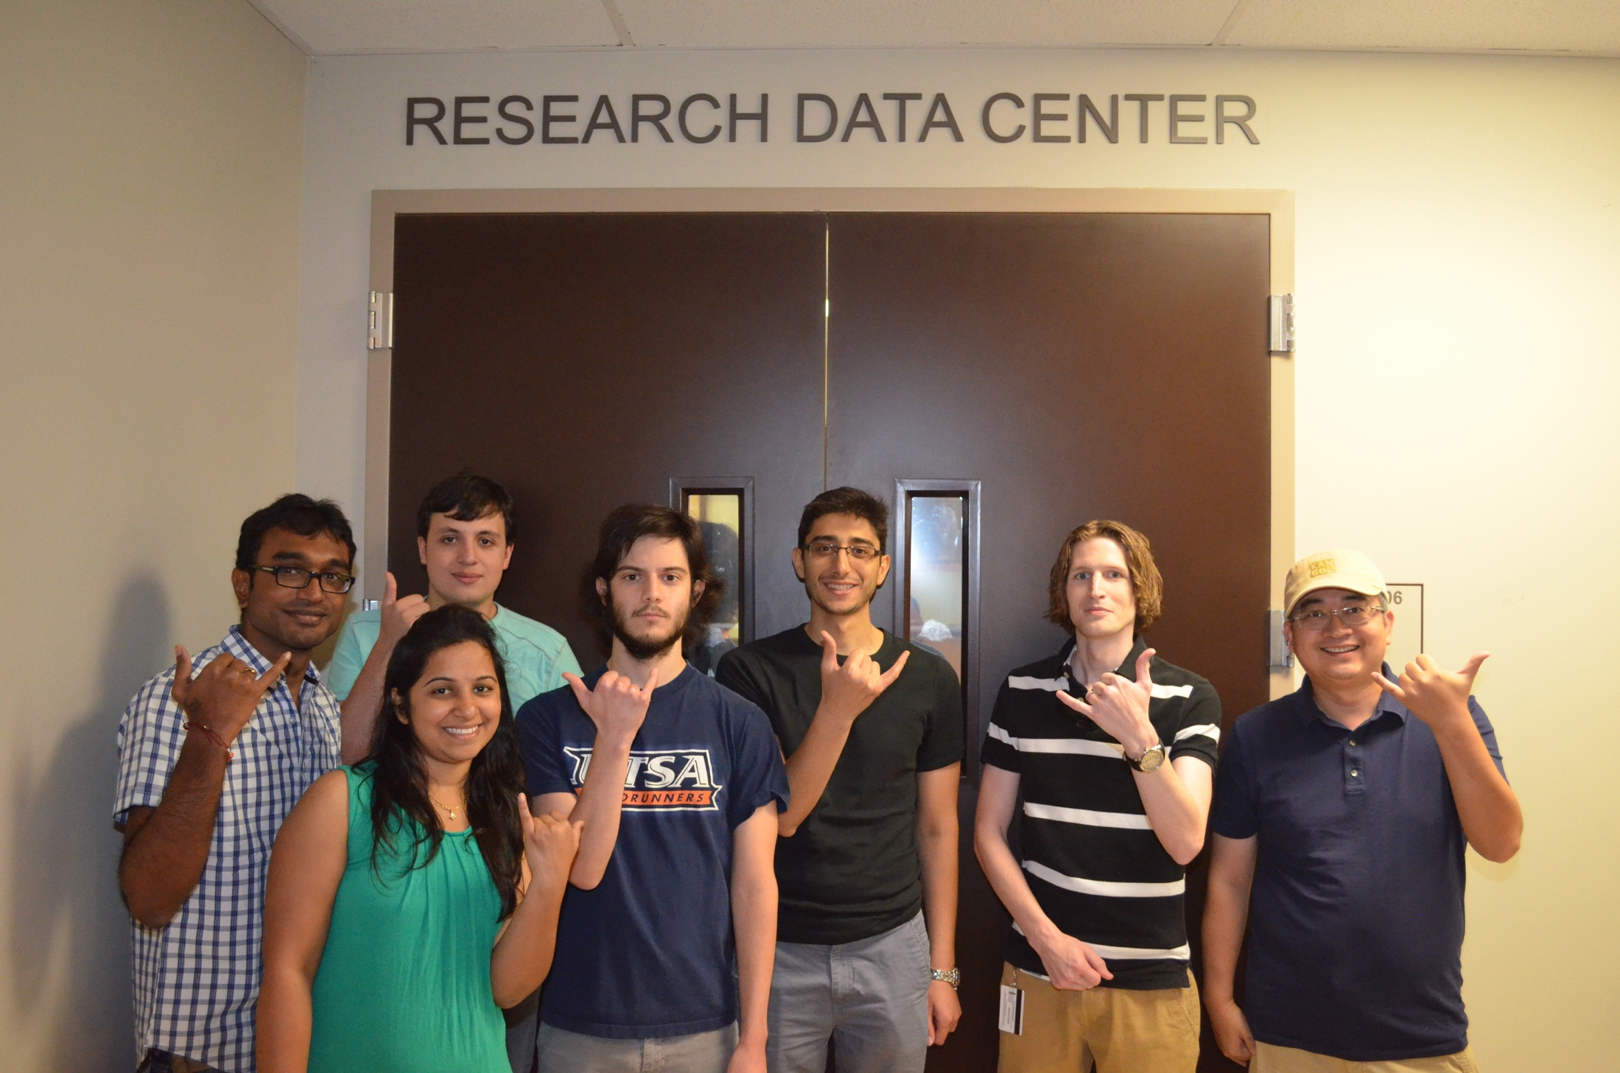
The Open Cloud Institute

Slide 32
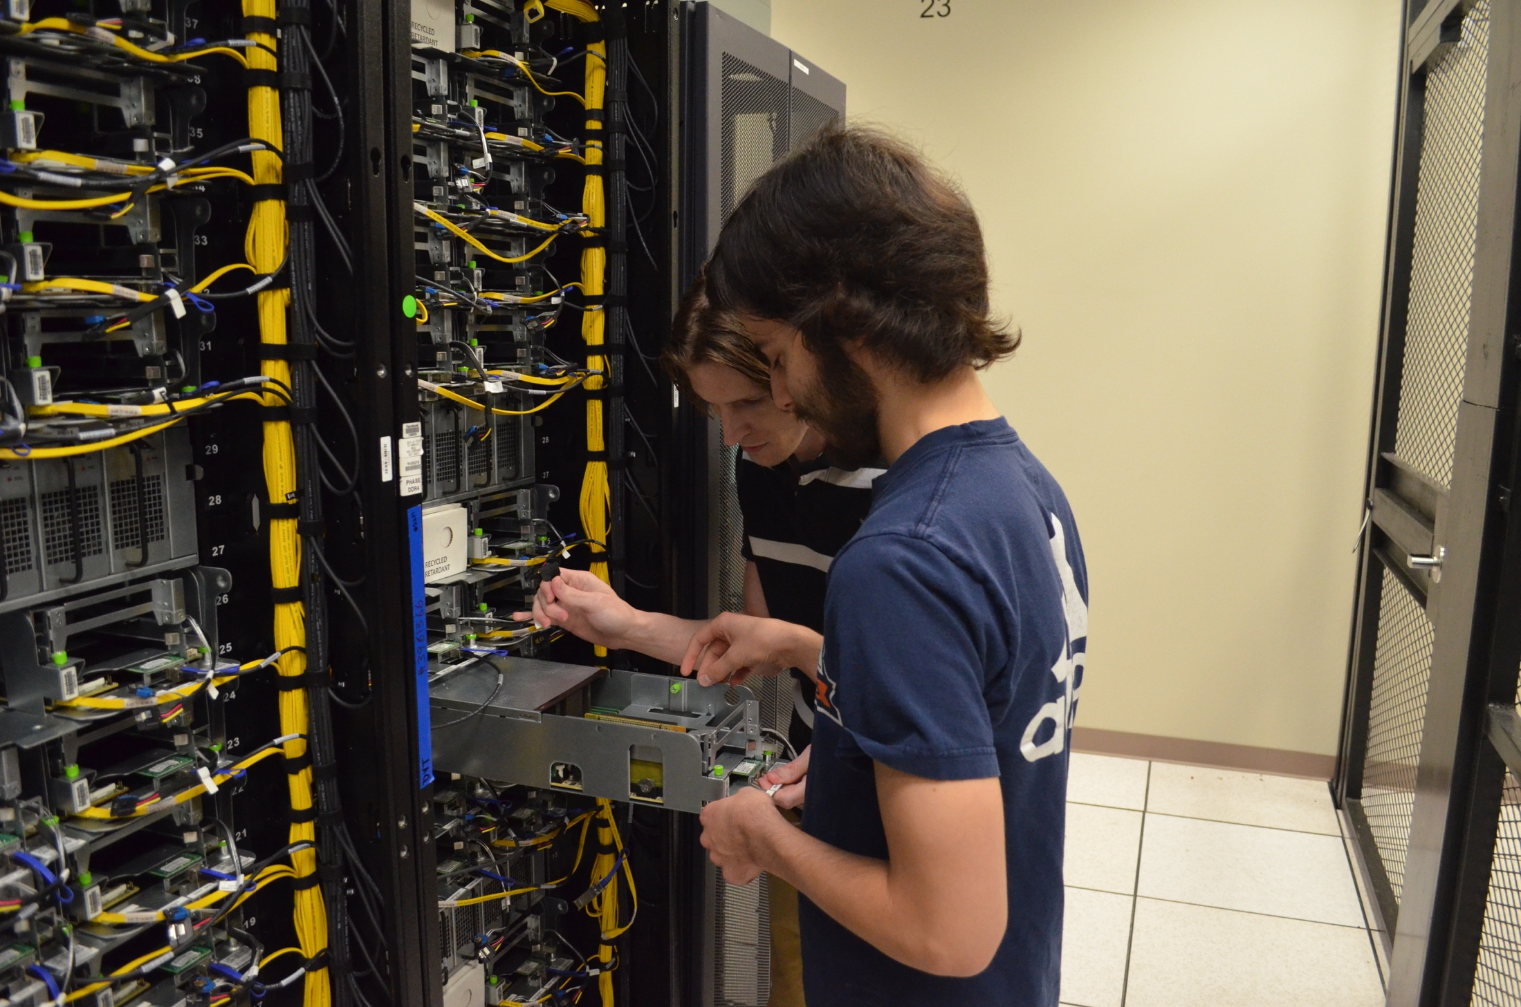
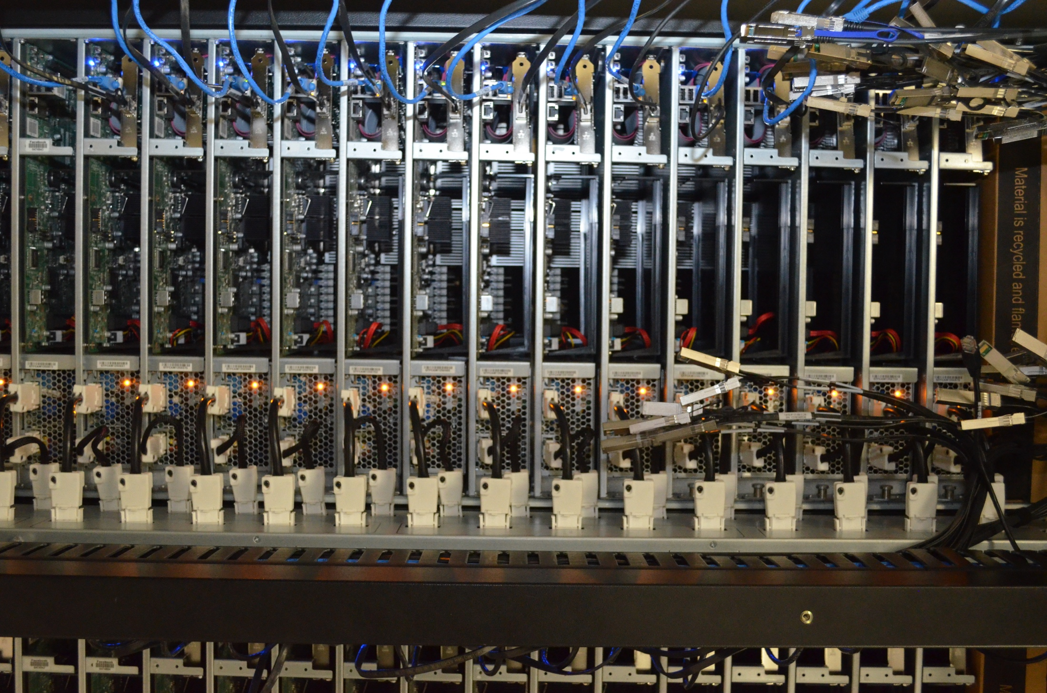
The Open Cloud Institute

Slide 33
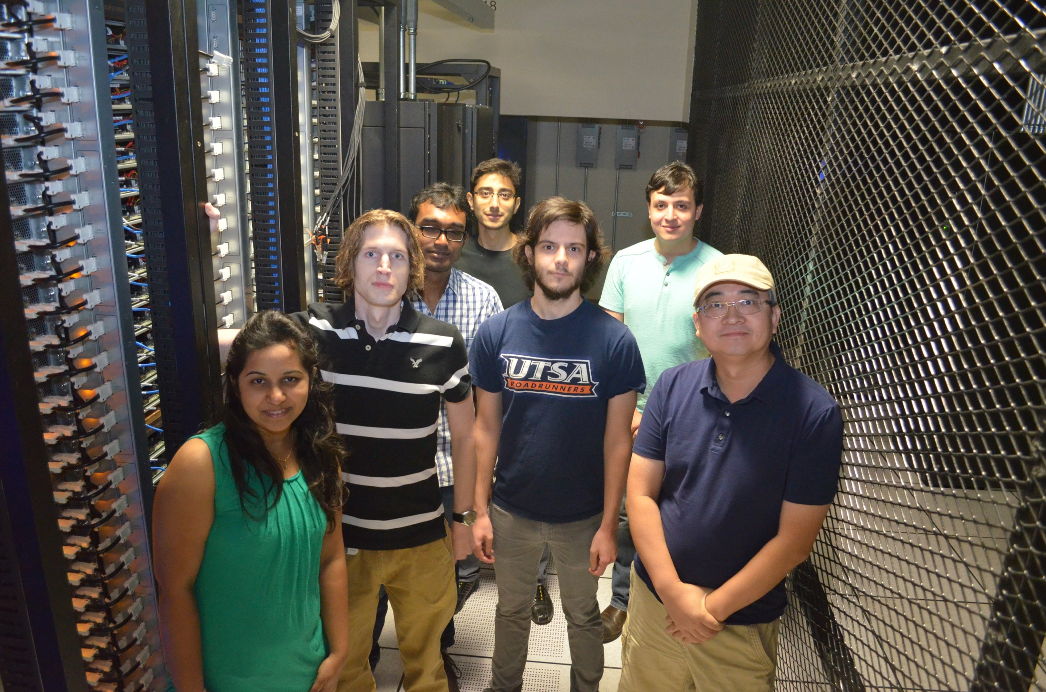
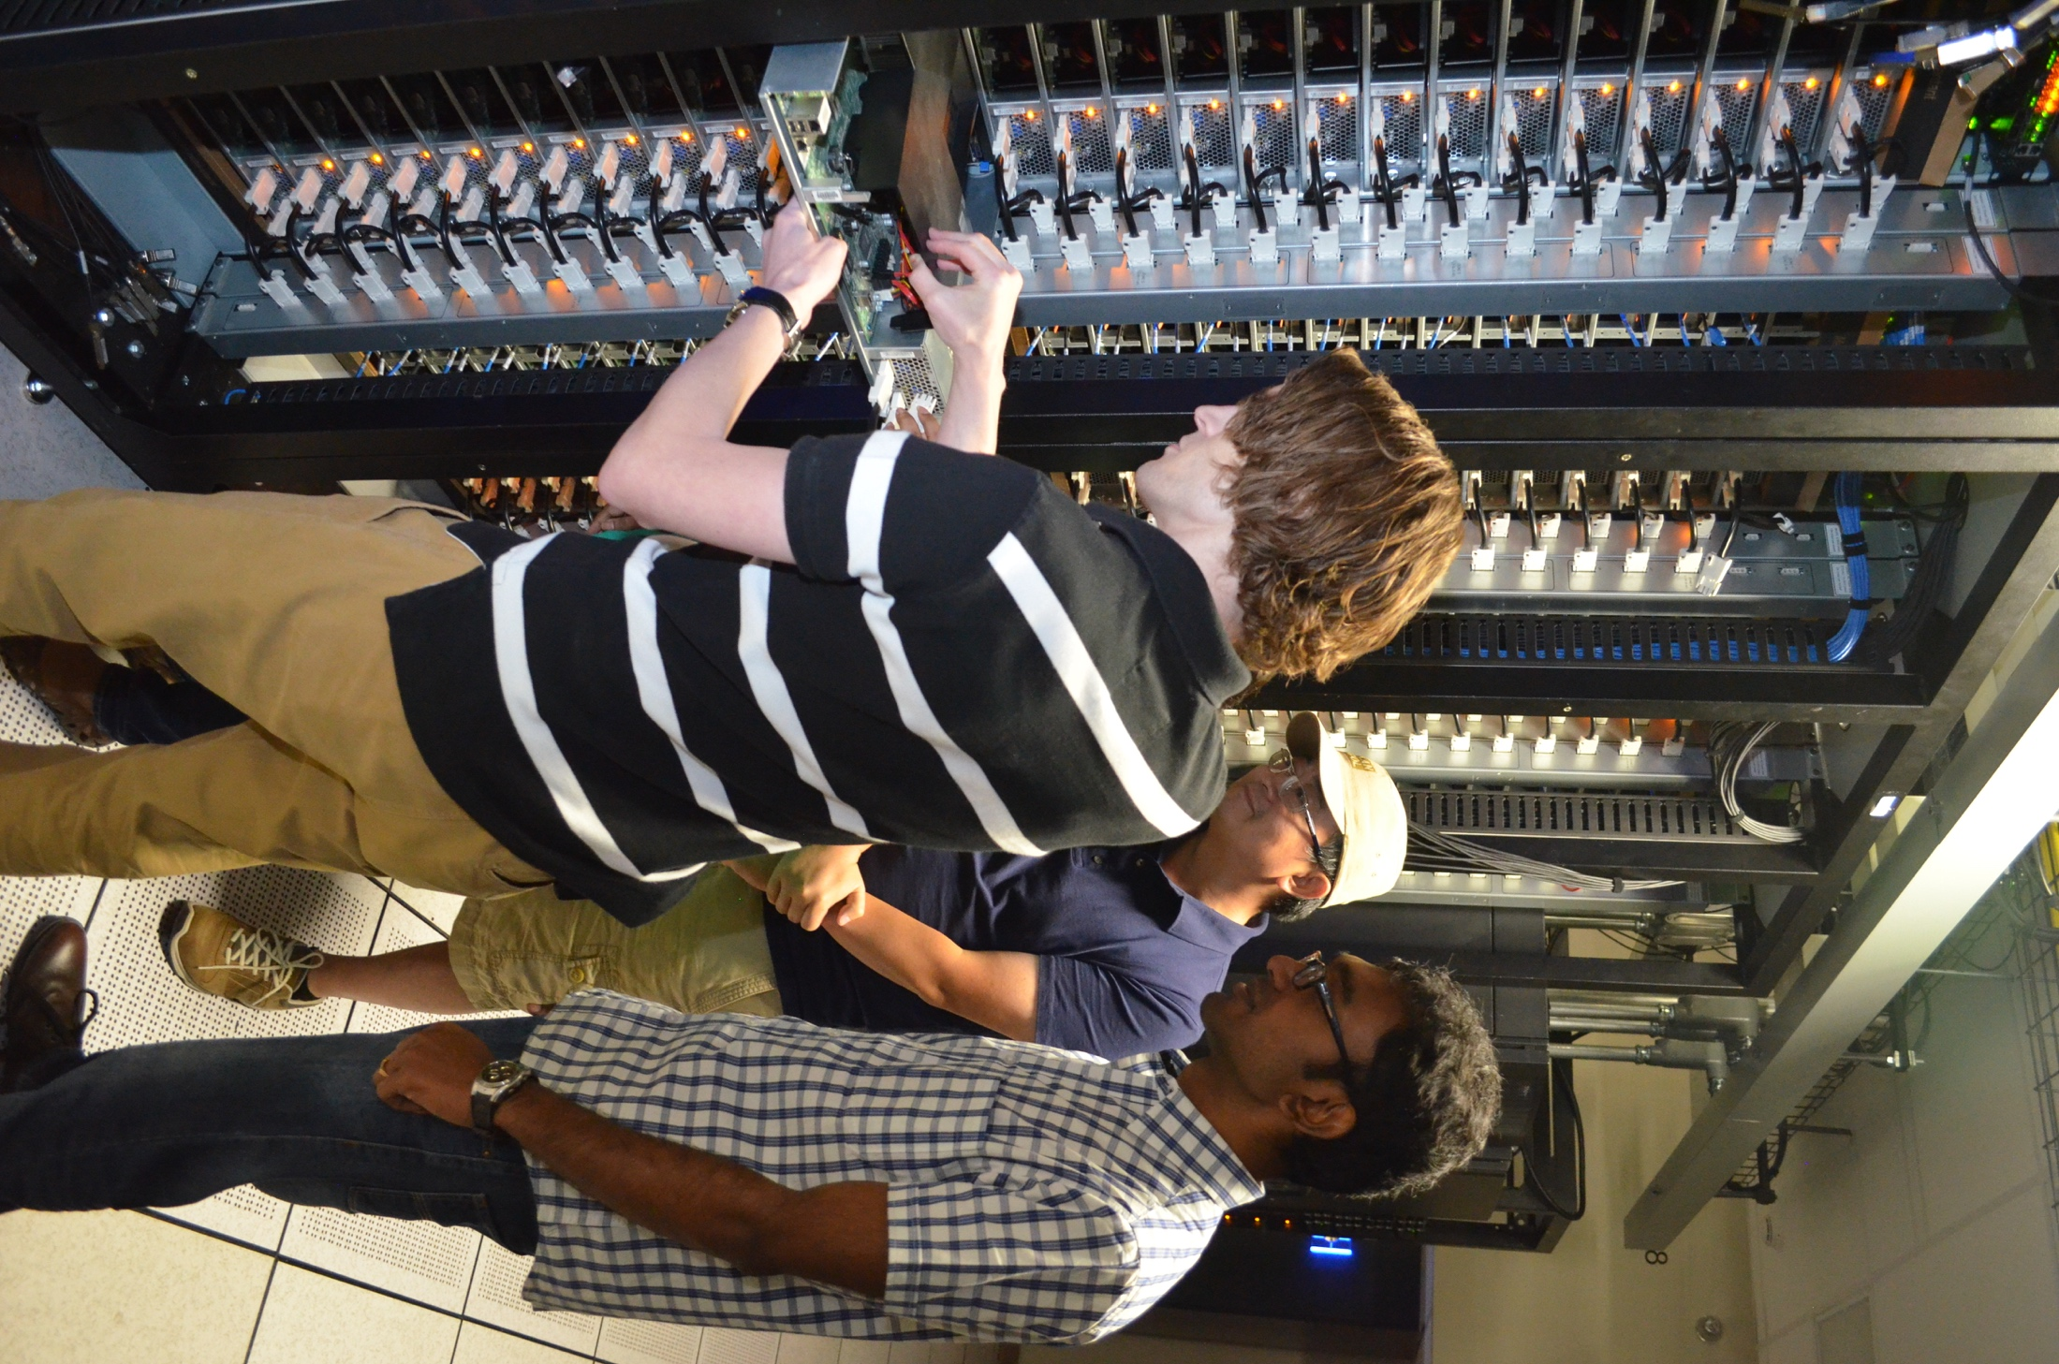
The Open Cloud Institute

Slide 34

Thank You!
“‘Tis the set of the sails,
And not the gales,
That tell us the way to go.”
Ella Wheeler Wilcox
(from The Winds of Fate)

